Slide 1
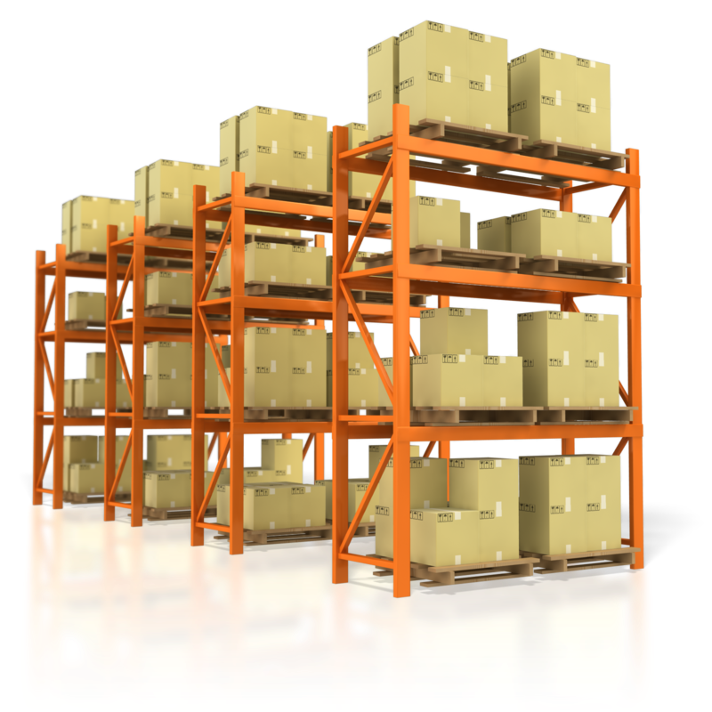

Your name

Slide 2
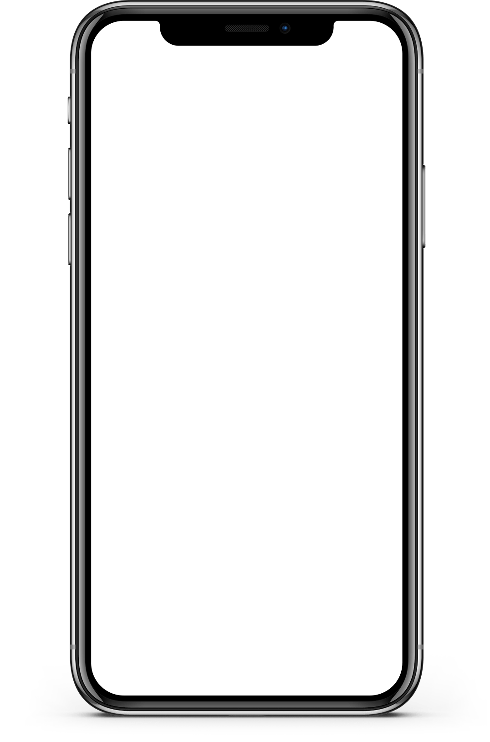
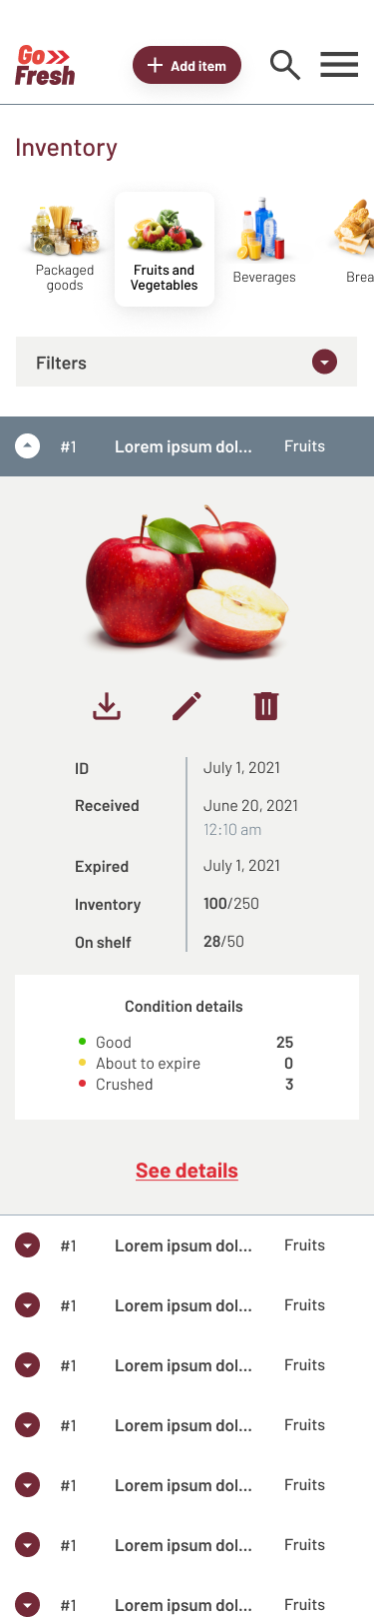
Project overview
THE PRODUCT:
A custom digital inventory management solution that helps retail store owners manage and track inventory management-related tasks.
Preview of selected polished designs.
PROJECT DURATION:
8 weeks; July 2023–September 2023

Slide 3
Project overview
THE PROBLEM:
Inventory management can be a cumbersome and time-consuming task for retailers. Now store´s owners are looking for a scalable technology solution that would aid the store’s inventory management, security, scalability, and efficiency.
THE GOAL:
Develop custom inventory management platform that would function seamlessly across different devices. This would replace cumbersome Excel sheets and provide the store´s owners with a secure and intuitive online/offline platform for managing and tracking inventory management-related tasks.

Slide 4
Project overview
MY ROLE:
This is an individual project that allowed me to plan and direct each step of the design thinking process as a UX strategic design student with mobile and web UI design experience.
RESPONSIBILITIES:
Conduct user research
Define the problem and provide insights to inform the ideation phase
Define personas, user journeys, empathy maps, and user flows
Visual design of low-fi and high-fi wireframes, prototypes, and user testing

Slide 5
User research
Personas
Problem statements
User journey maps
Understanding
the user

Slide 6
User research: summary
To understand user frustration, needs, and requirements, I conducted foundational research through interviews and user surveys for my project. My goal was to gain insights to understand the processes users go on their daily business operations.
There are two types of user research methodologies: qualitative and quantitative research. I chose qualitative research because I had a time constraint.

Slide 7
User research: pain points
1
2
3
4
CHAOTIC INVENTORY STORAGE AREA
INVENTORY TAKES TOO LONG
TRANSFERRING WRITTEN DATA
LOSSES
The inability to properly record inventory has caused loss of stock and profits. The solution should accurately update stock numbers based on sales and returns.
Messy and distracting environment not conducive to keeping good inventory management practices.
Not enough time and help to perform all processes.
Need to find a way to streamline some of the tasks to optimize time spent on the overall process.
Challenges transposing from paper to computer. Solution should be able to digitize written inventory records.

Slide 8
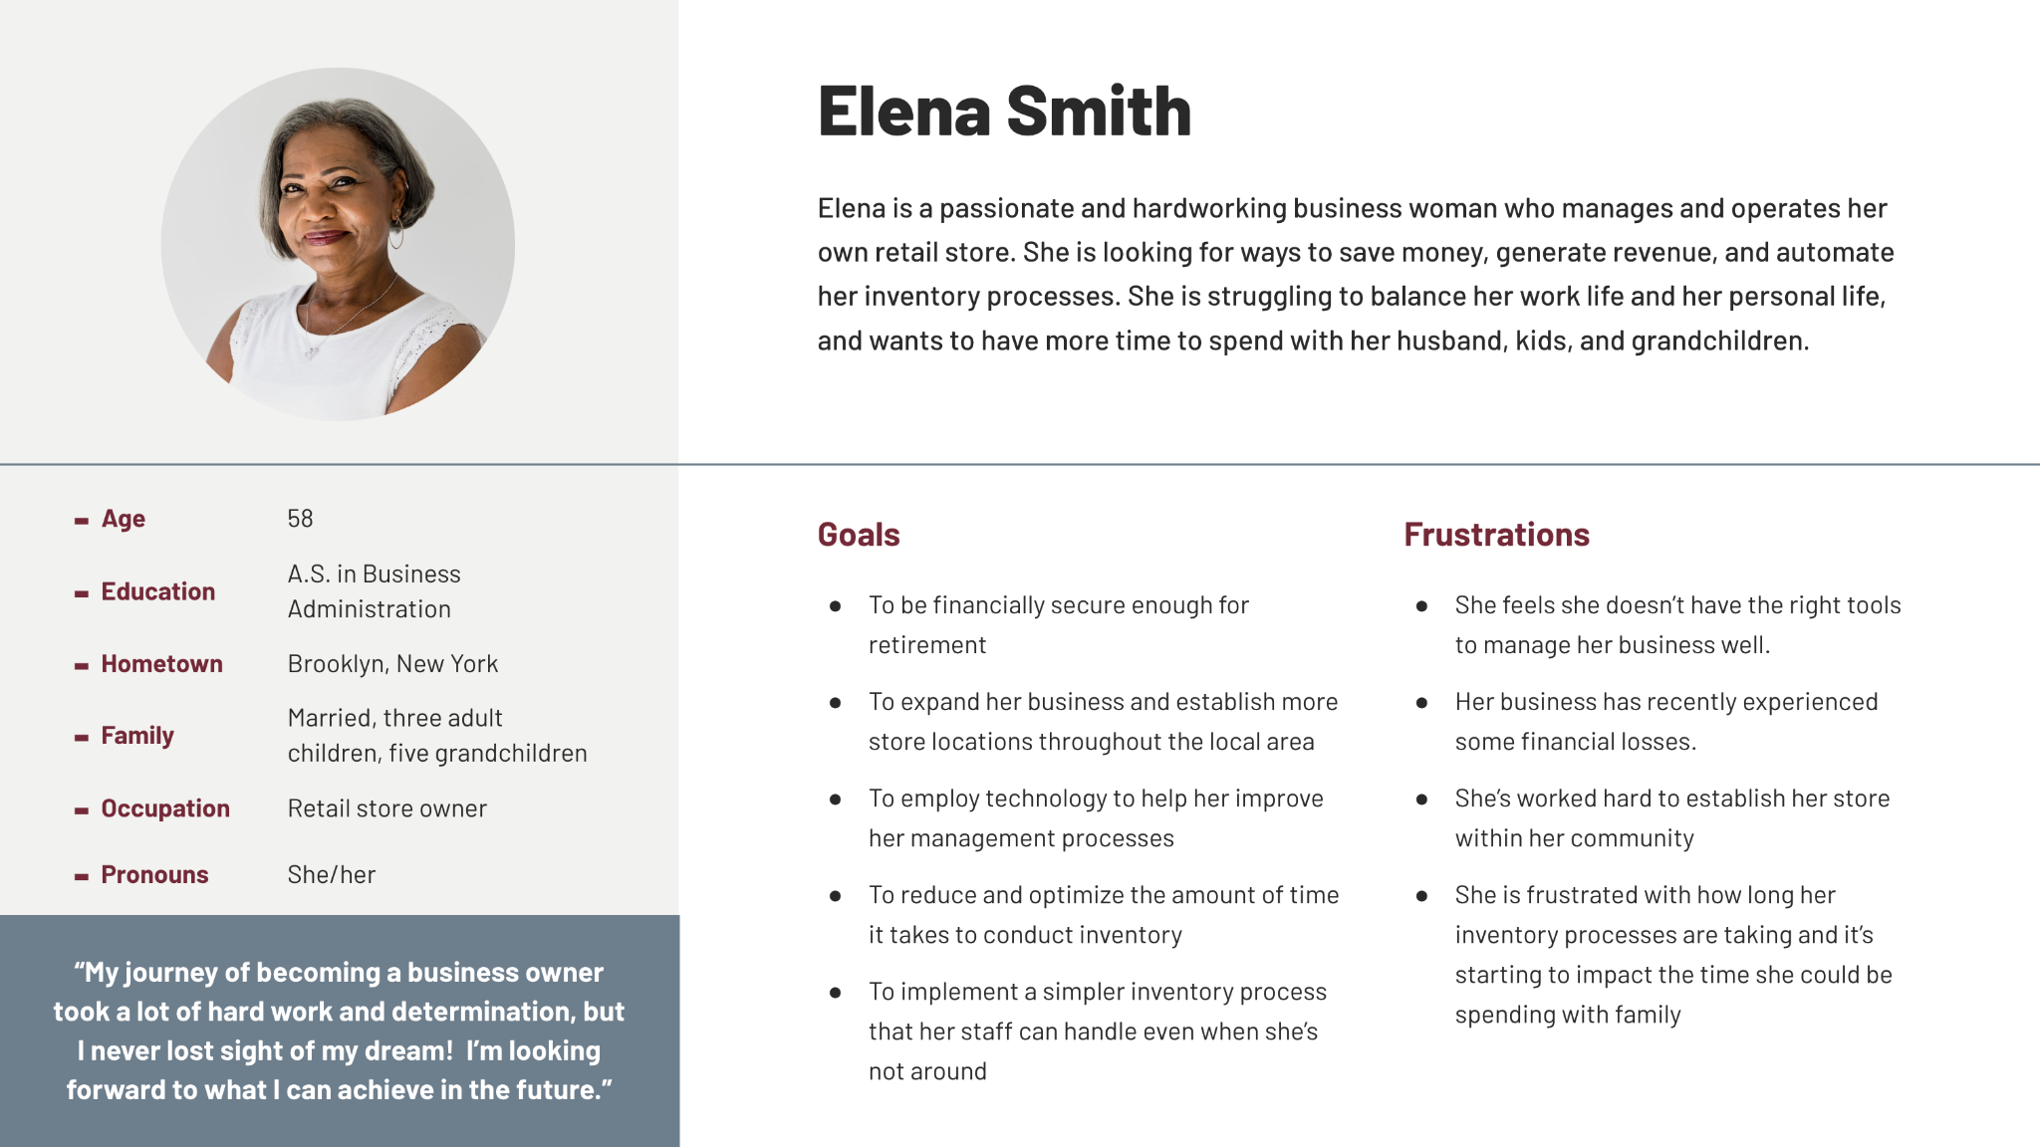
Persona: Name
PROBLEM STATEMENT:
Elena is a professional businesswoman working in her own retail store. She is looking for ways to save money and automate her store´s inventory processes.

Slide 9
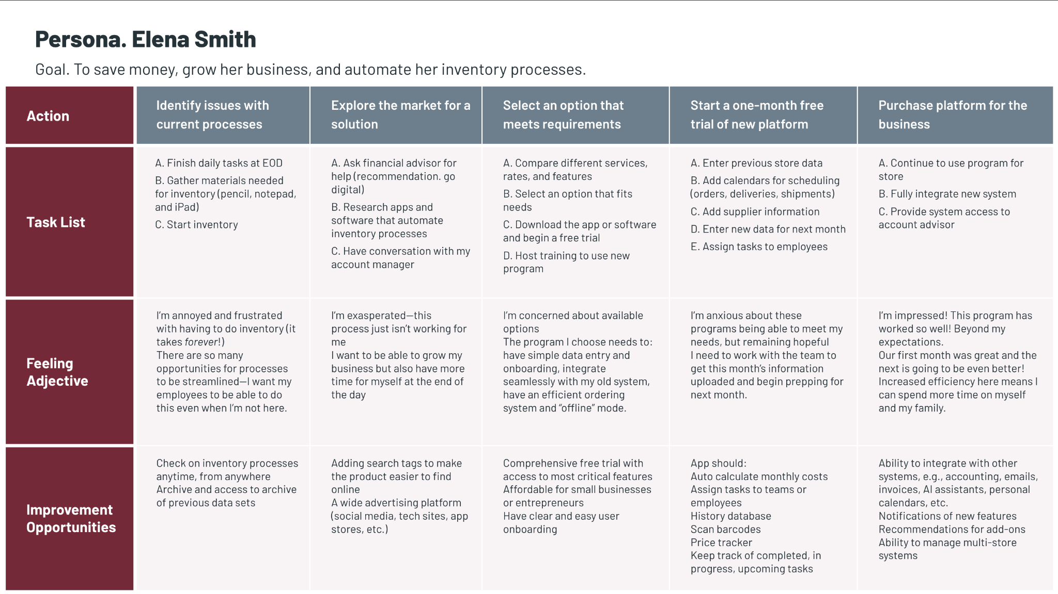
User journey map
By creating user journey maps, I wanted to illustrate the process of how Elena behaves, feels, and what she thinks while accomplishing her goals to address pain points or provide moments of delight.

Slide 10
Sitemap
Paper wireframes
Digital wireframes
Low-fidelity prototype
Usability studies
Starting
the design

Slide 11
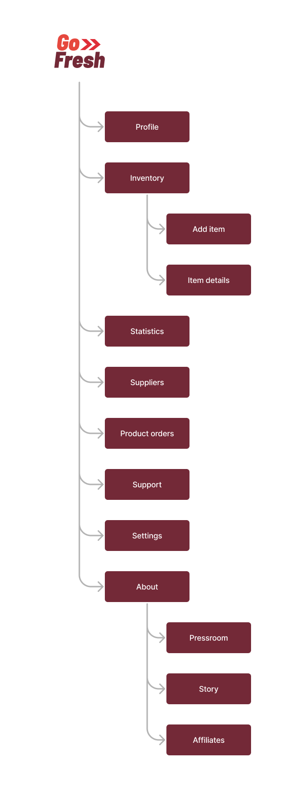
Sitemap
I built user-focused flows to ensure that my personas can successfully complete their key objectives while reducing the existing pain points.
To view a larger version of this sitemap, follow the link here.

Slide 12
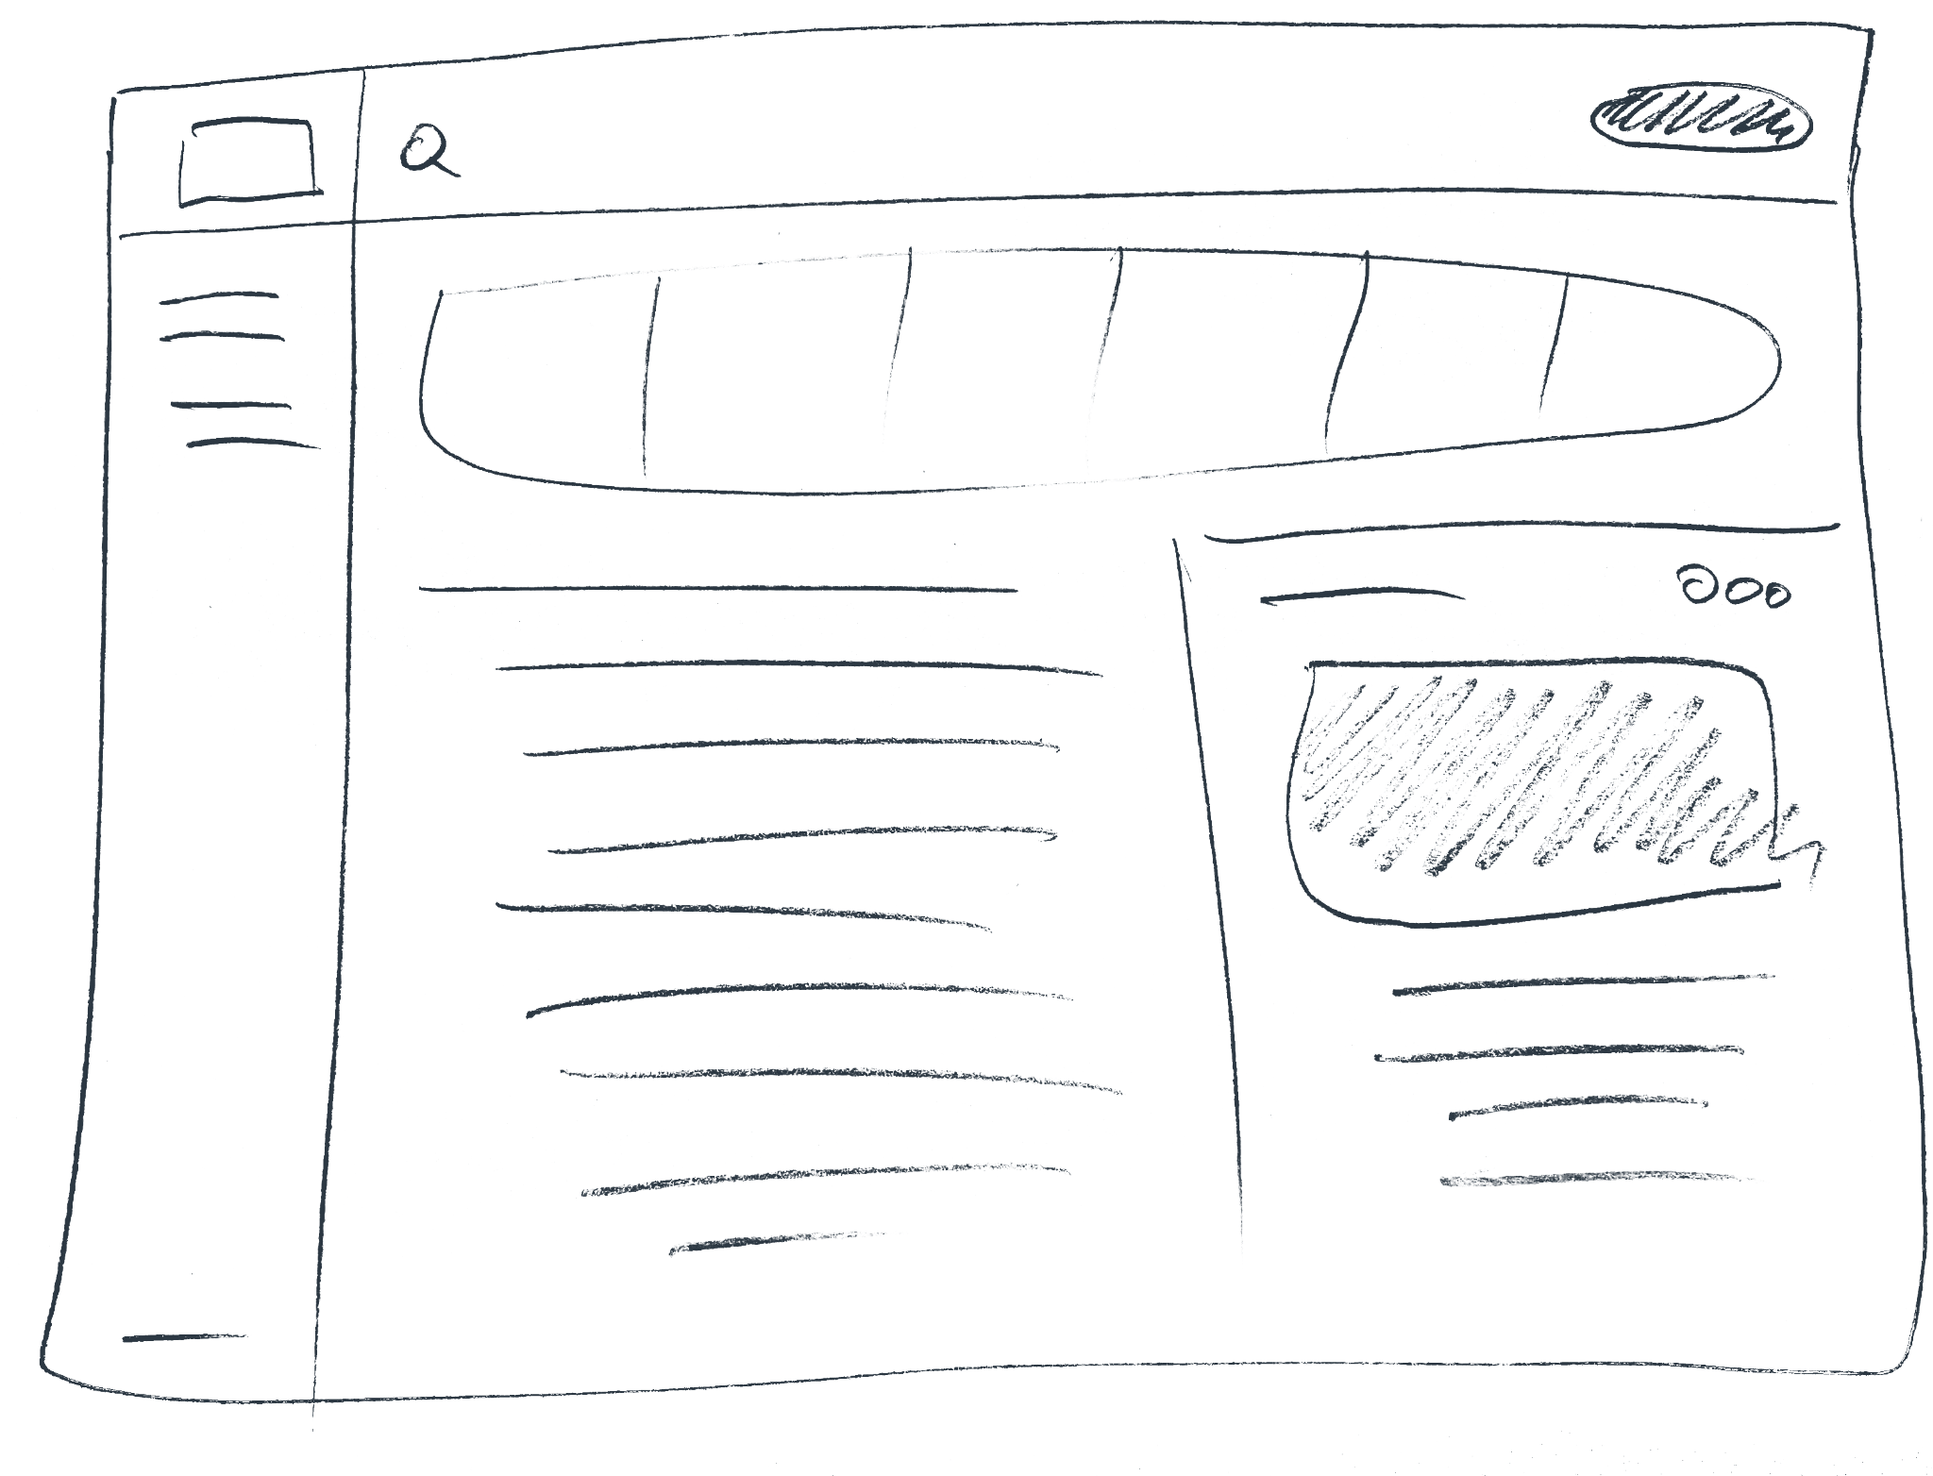
Paper wireframes
Focusing on the core features identified during user research, I sketched the first wireframes using pen and paper.

Slide 13
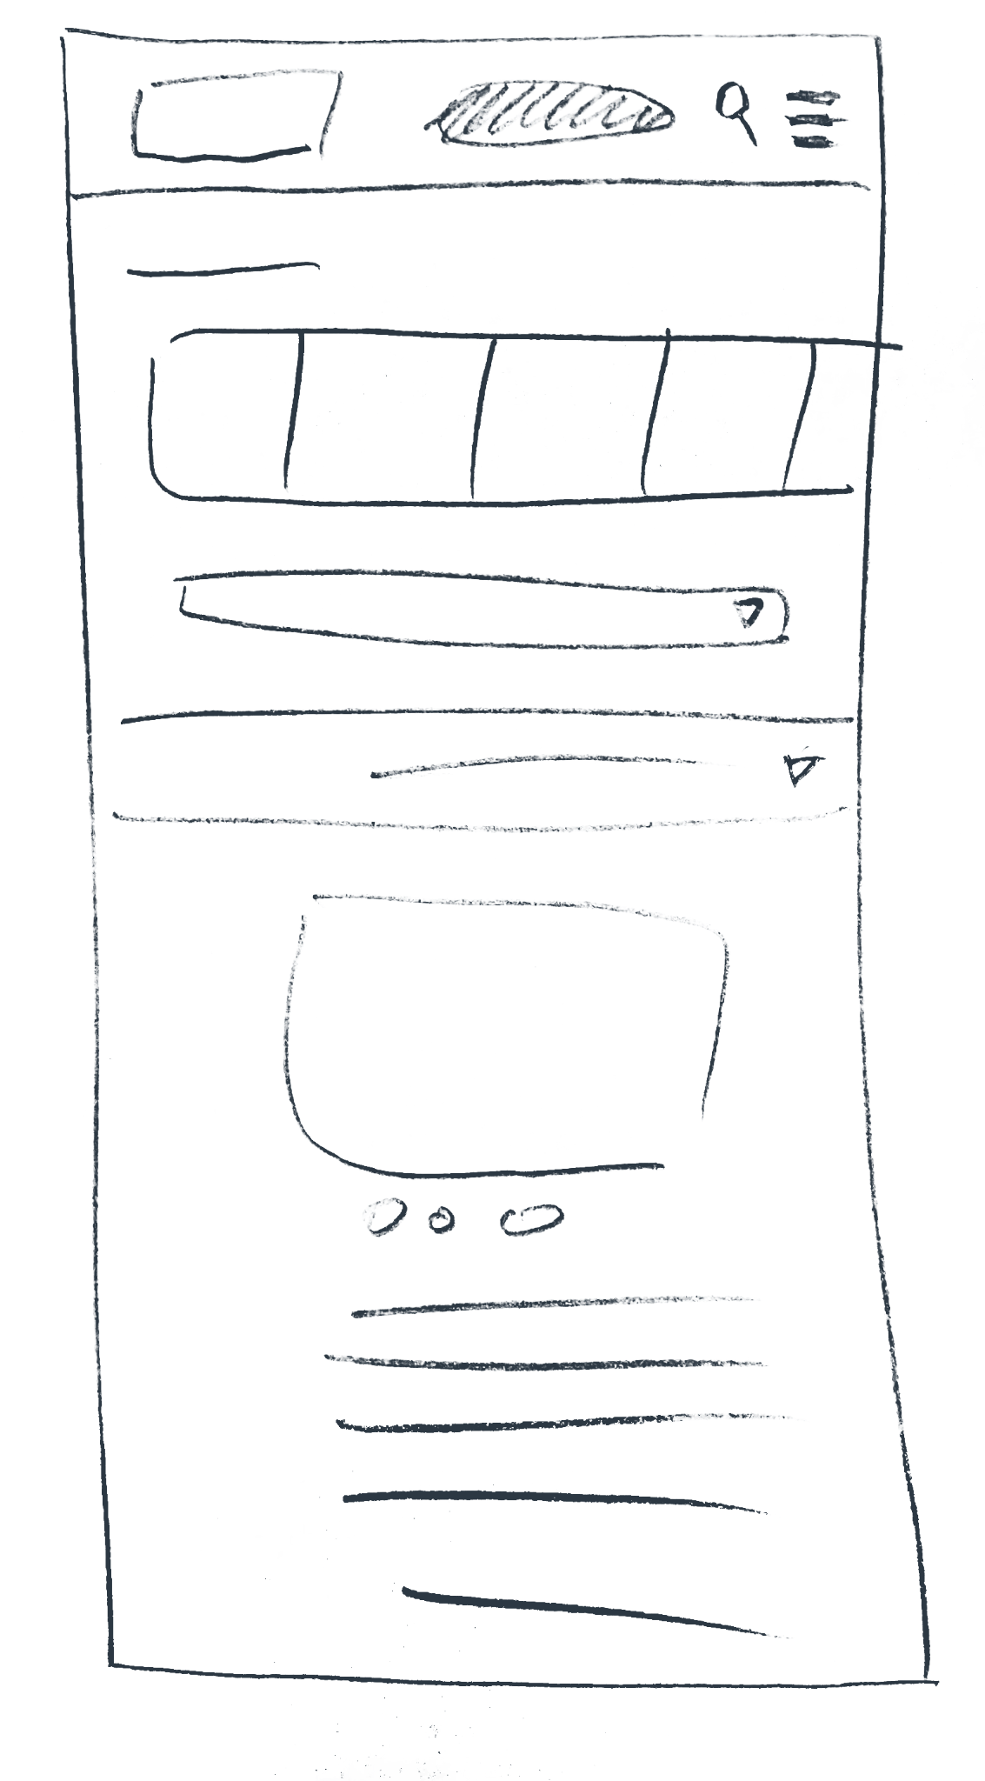
Paper wireframe
screen size variation(s)
I drafted iterations of each screen on paper.
I also started to work on designs for additional screen sizes to make sure the site would be fully responsive.

Slide 14
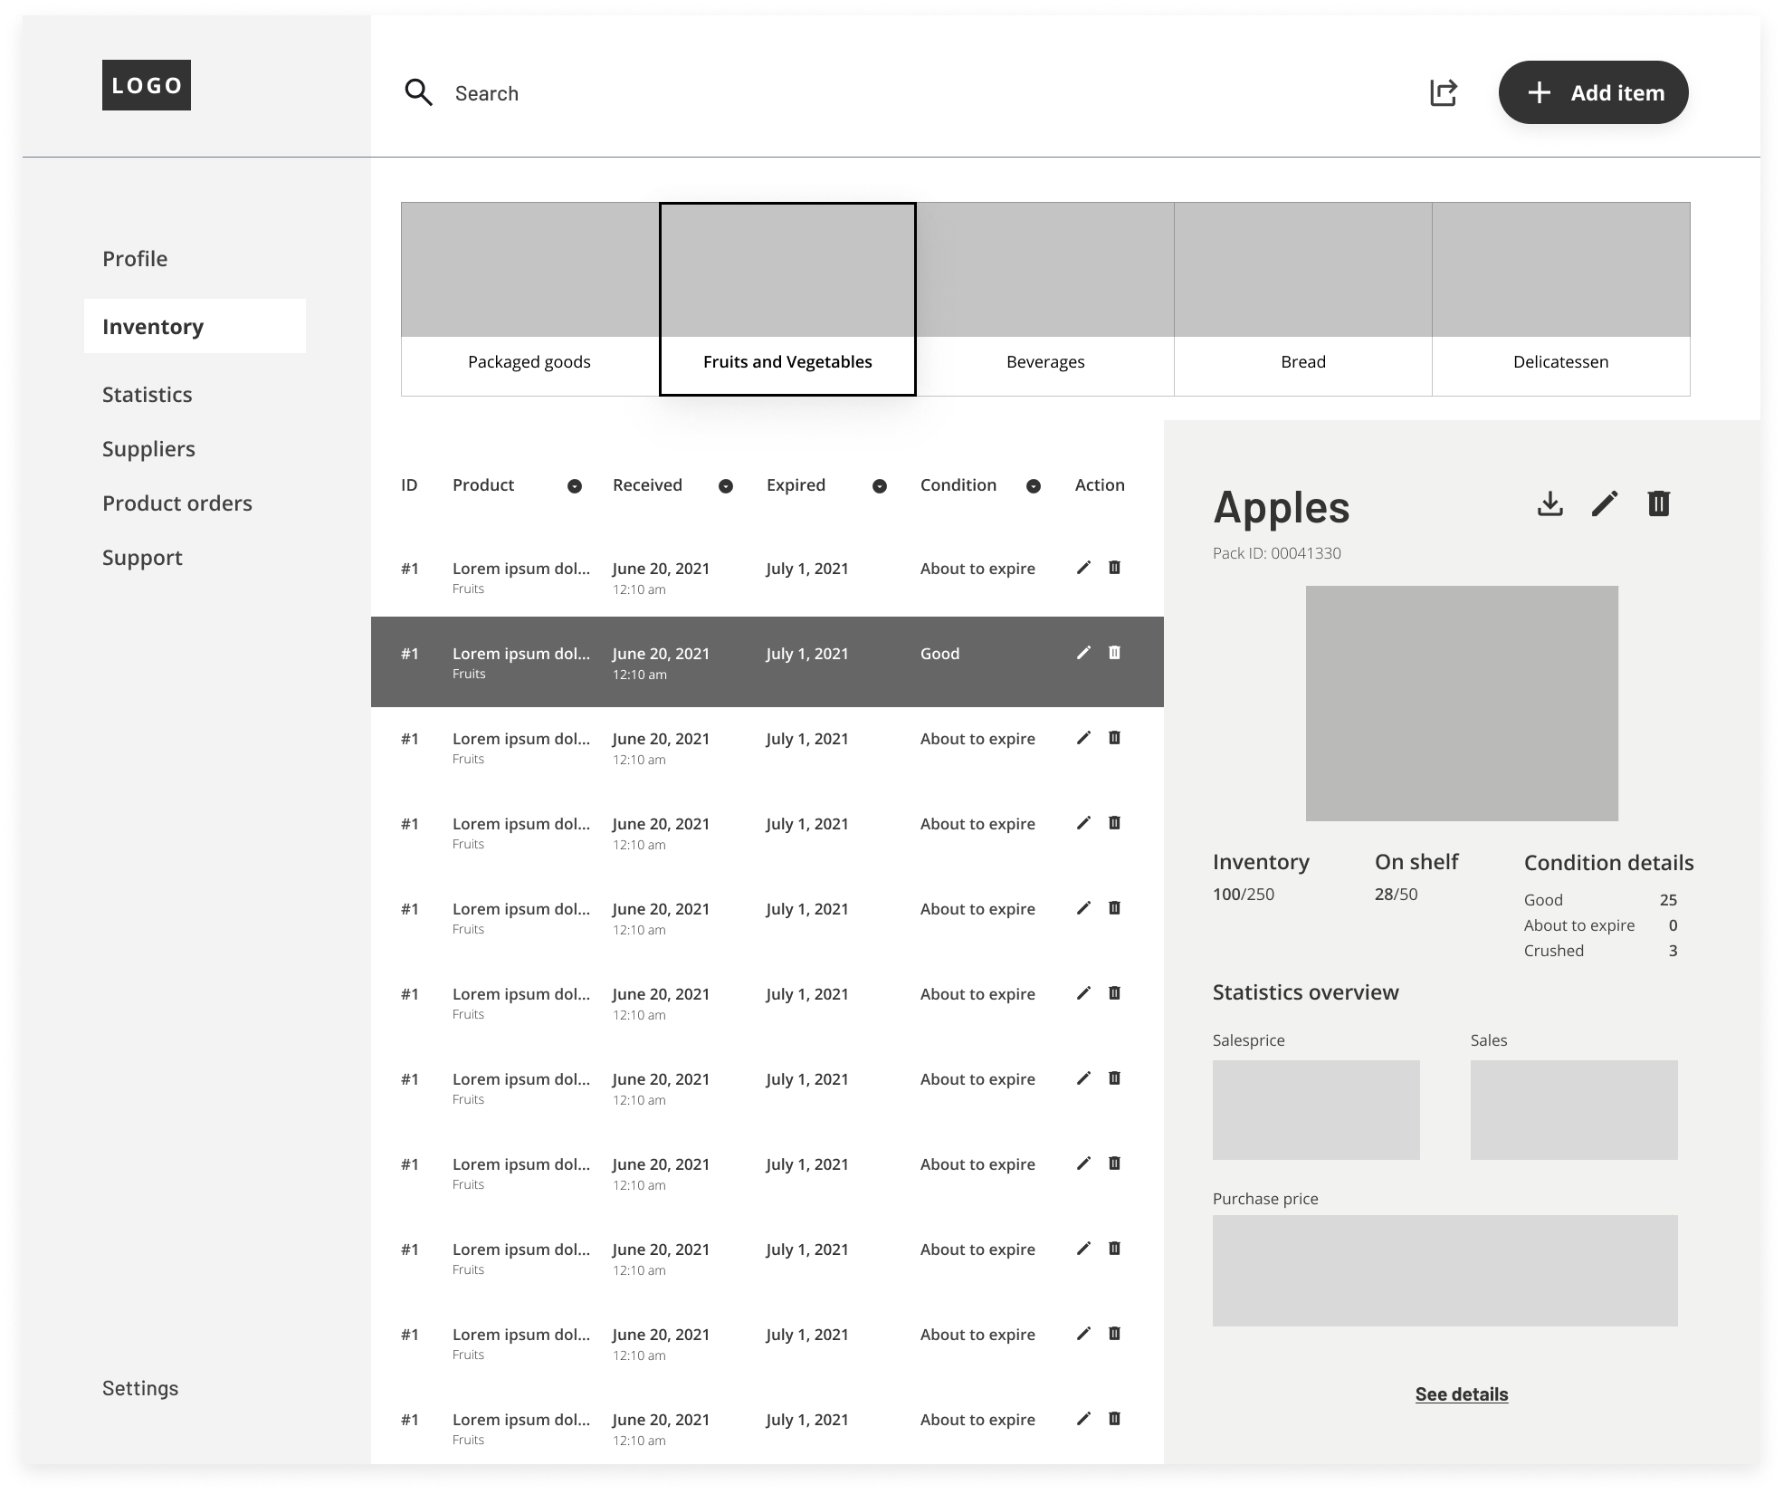
Digital wireframes
Using wireframes, I put my ideas on paper first and then started to make high-fidelity wireframes. After dozens of iterations, these are the wireframes that best represented user flow and met user needs.
Dashboard with a list view of all items
Description and statistics for each product

Slide 15
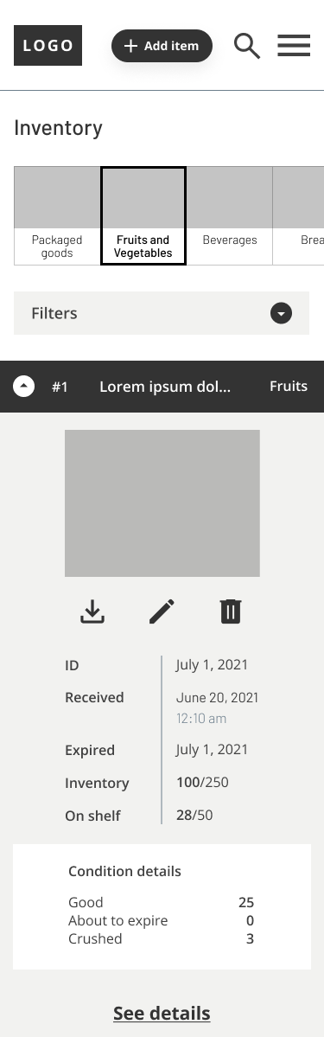
Digital wireframe
screen size
variation(s)
I also started to work on digital wireframes for additional screen sizes to make sure the site would be fully responsive.

Slide 16
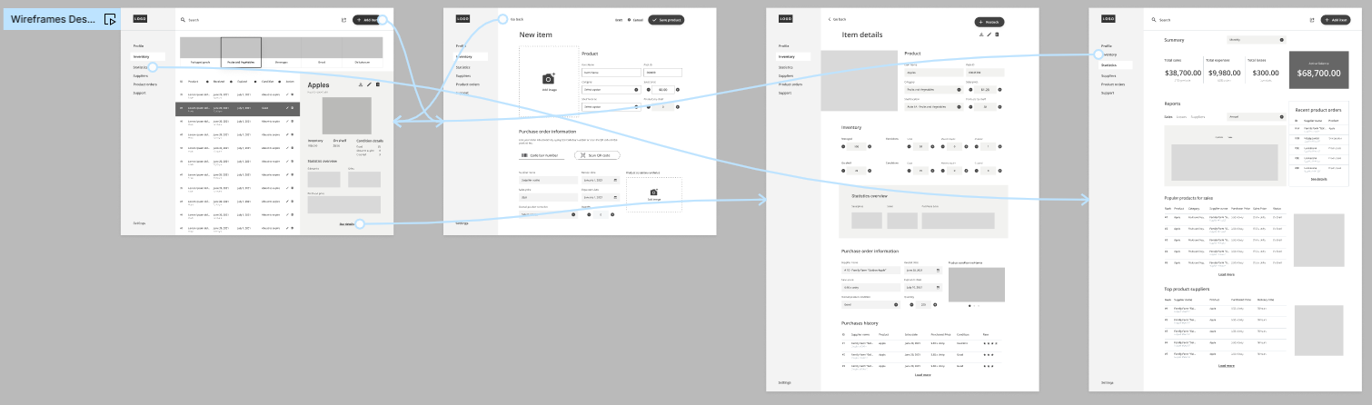
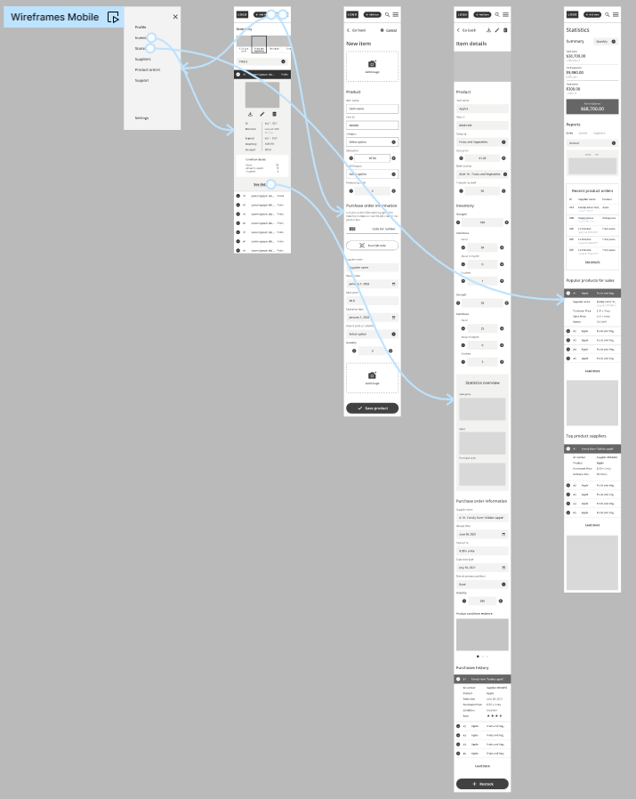
Low-fidelity
prototype
I created a low-fidelity prototype from the user flow diagram and wireframes to test functionality before incorporating it into the final design and ensure accessibility for end-users.
View Prototype:
Desktop
Mobile

Slide 17
Usability study: parameters
STUDY TYPE:
Unmoderated usability study
LOCATION:
United States, remote
PARTICIPANTS:
4 participants
LENGTH:
20-30 minutes

Slide 18
Usability study: findings
Now that I have the key insights from the usability study, let's look at the findings and define the actual problems that a designer can solve.
1
2
3
FINDING
FINDING
FINDING
Users had a hard time knowing where to start. Clearer instructions can help users start their tasks.
Adding an item seems to have several steps. Dividing into sections and adding stepper components can help to create a seamless flow experience on this task.
The Settings icon is out of sight for users. Moving it to a more intuitive place next to the principal menu can improve its visibility.

Slide 19
Refining
the design
Mockups
High-fidelity prototype
Accessibility

Slide 20
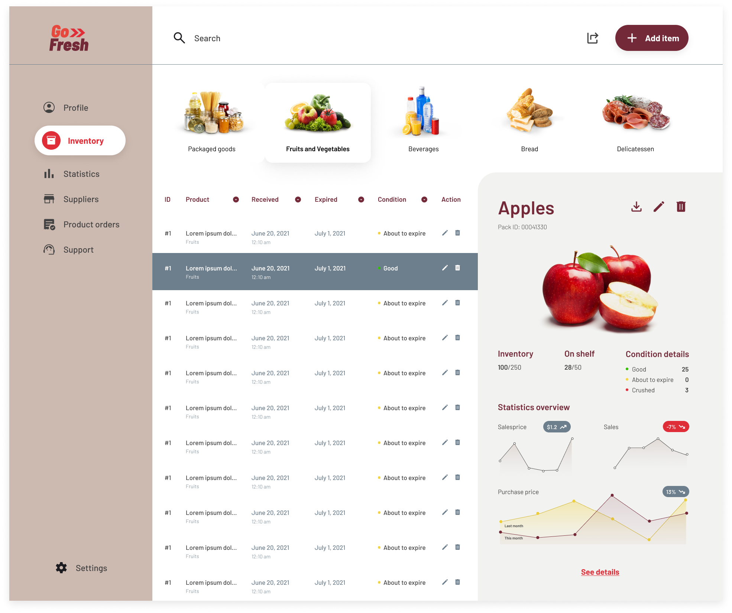
Mockups
Based on insights from the usability studies, I applied design changes such as adding an item task flow, providing clear instructions, and simplifying the navigation.
Before usability study
After usability study

Slide 21
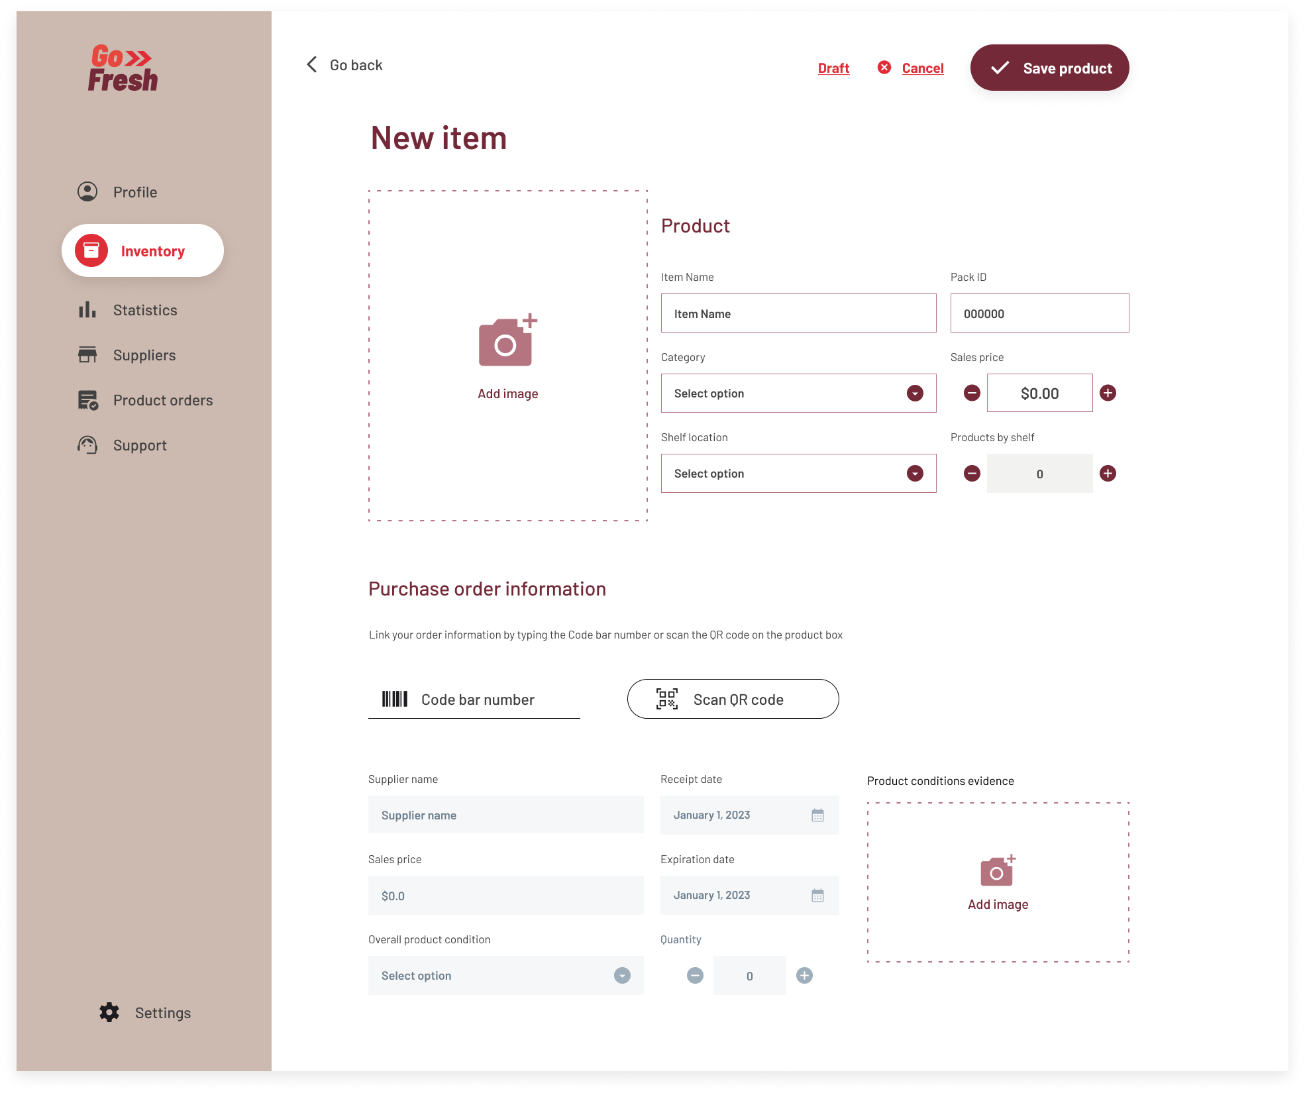
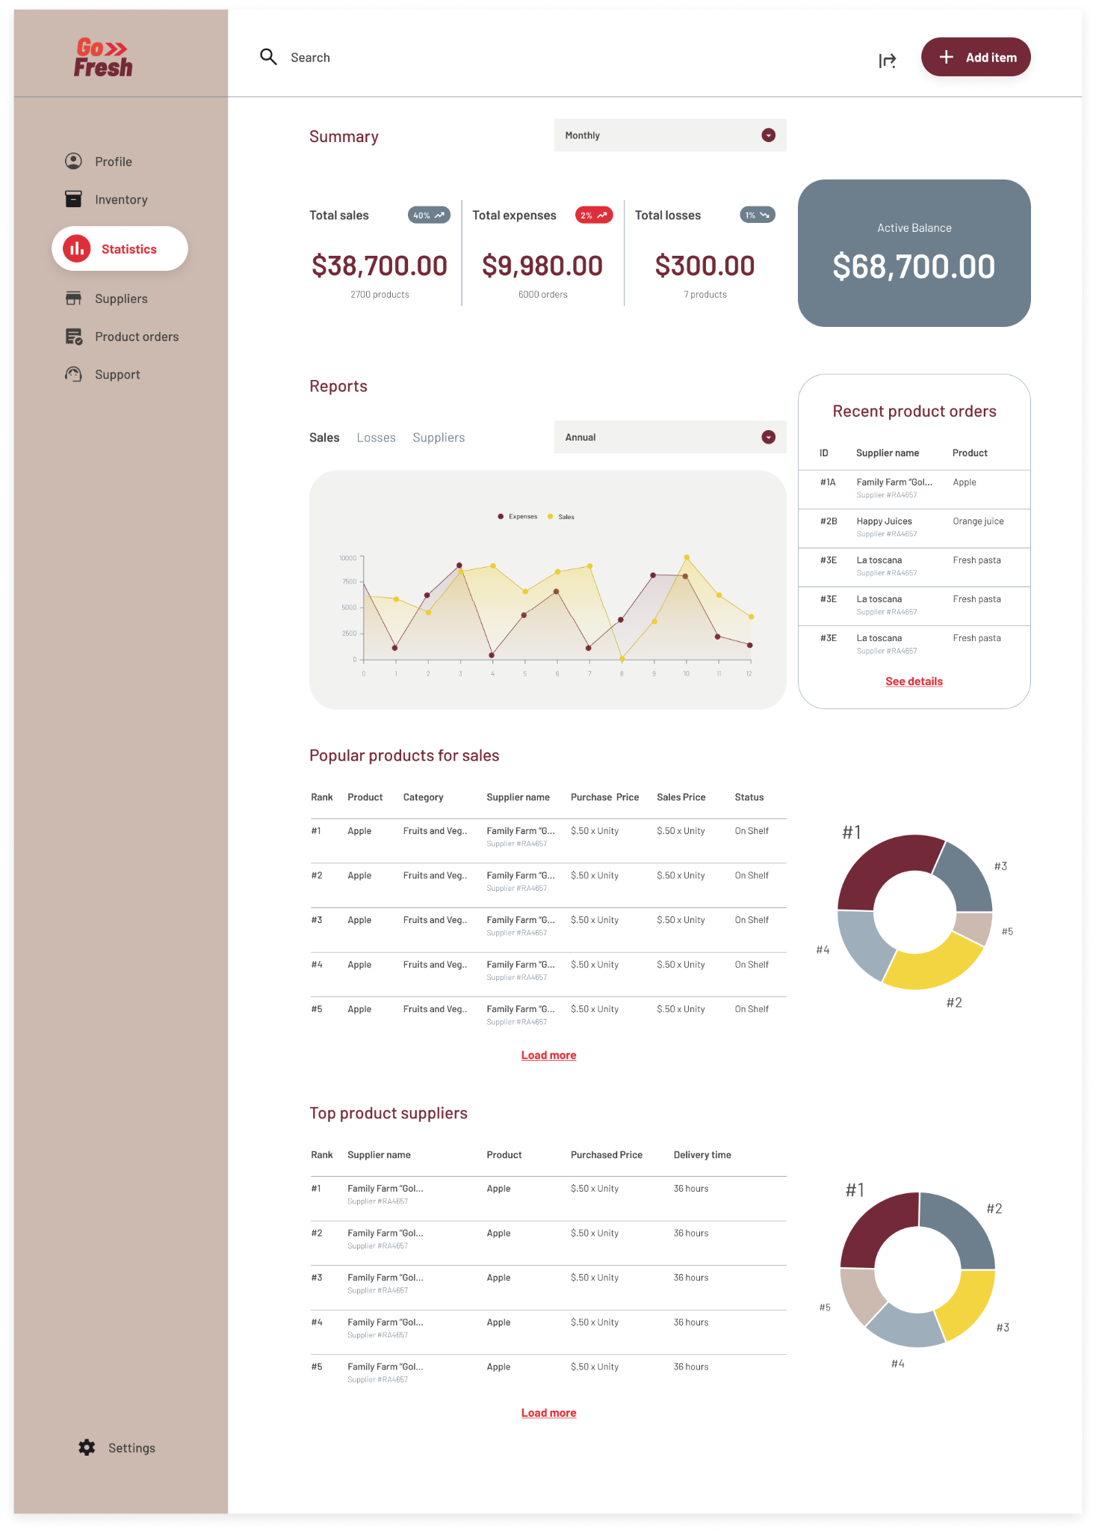
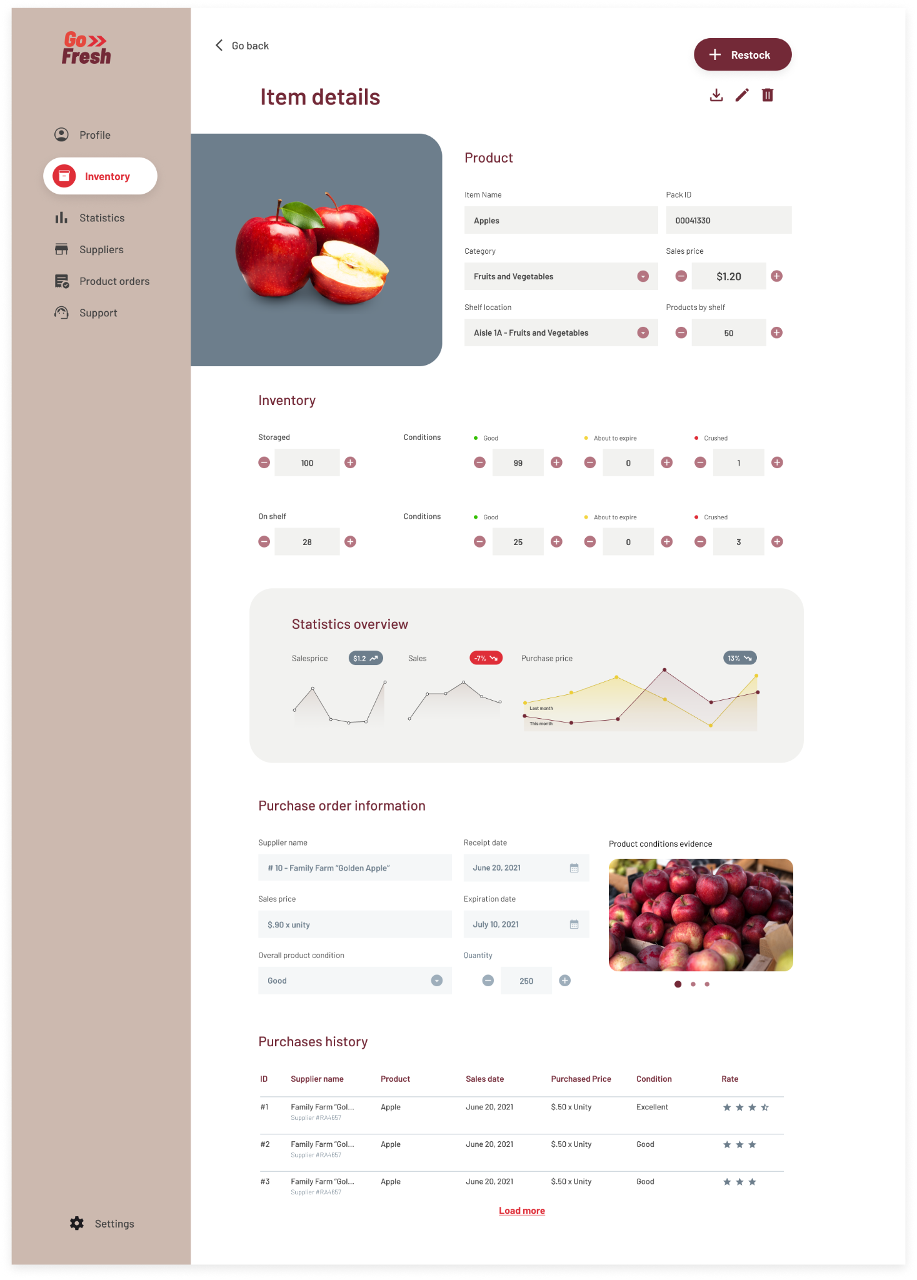
Mockups: Original screen size

Slide 22
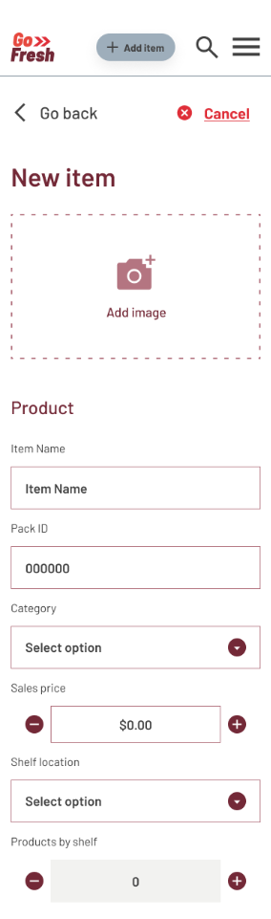


Mockups: Screen size variations

Slide 23
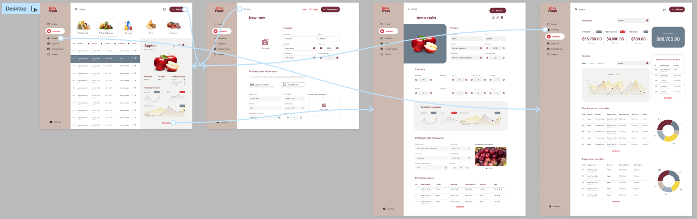
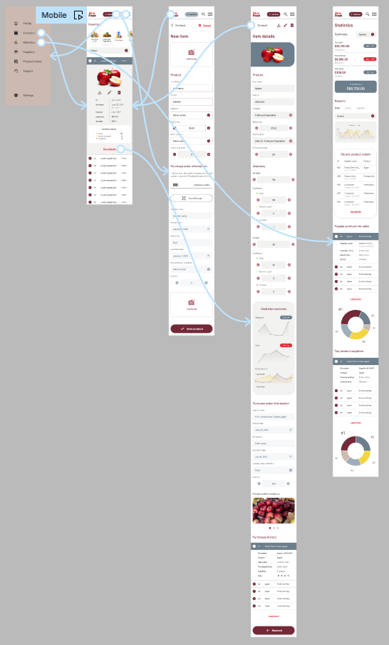
High-fidelity prototype
After finalizing the low-fidelity prototype, I worked on creating the final designs with the goal of making them simple and intuitive. The main color theme I used was red because it’s a very powerful color that symbolizes strength, power, and action. I thought it was very representative of the persona’s character.
View Prototype:
Desktop
Mobile

Slide 24
Accessibility considerations
1
2
3
When choosing a color palette, I made sure my primary colors met WCAG AA Compliance before building out the UI for each screen.
I am using only two typefaces: Barlow for headlines and Raleway for body copy.
Mixing too many different typefaces can make your app seem fragmented and busy.
I implemented a text hierarchy throughout the app. This helps users to distinguish the different sections and information on screen.

Slide 25
Going forward
Takeaways
Next steps

Slide 26
Takeaways
IMPACT:
The design strategy included an efficient concept design that increases task efficiency multifold, and improves engagement with the application.
The retail store has ensured its potential for future growth with a scalable and secure solution that has streamlined the store´s inventory management operations.
WHAT I LEARNED:
While designing this app, I learned that the first ideas for the app are only the beginning of the process. Usability studies and peer feedback influenced each iteration of the app’s design.

Slide 27
Next steps
1
2
3
Obtain UX/UI feedback from designers with more experience in the field to improve the overall design and functionality.
When I have documented all feedback that was provided, I will make the necessary design updates in order to improve the app’s overall experience.
Create a cross-platform responsive design. The goal is to build the same experience for all users, no matter what type of device they are using.

Slide 28
Let’s connect!
I would appreciate your thoughts and insights on this topic, as feedback is crucial to further enhancing the findings of this study.
Provide your contact information here. This might include your email address, phone number, and website or link to other professional platforms.

